Slide 1

Data Structures
Stack – Linked List Implementation

Slide 2

Stack – Linked List Implementation

Slide 3
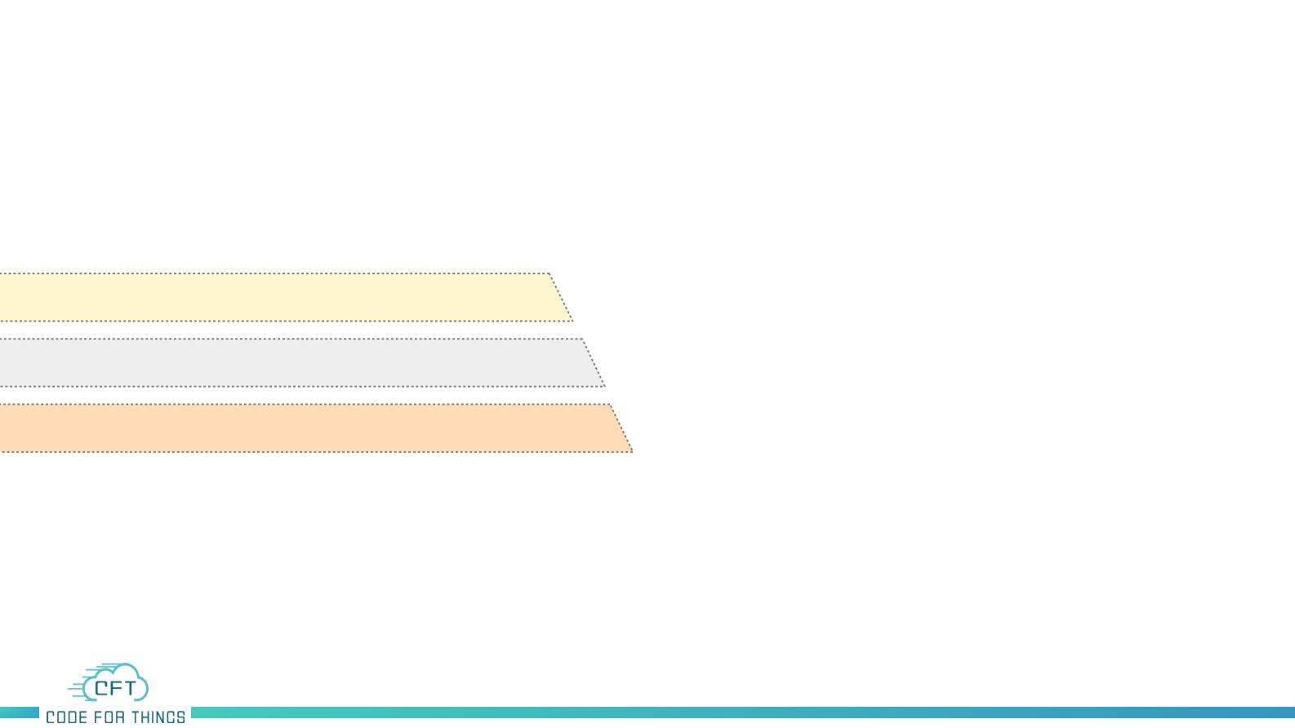
Data Structure –Stack Linked list
Operations
Insert an Element
Delete an Element
Print top Element

Slide 4
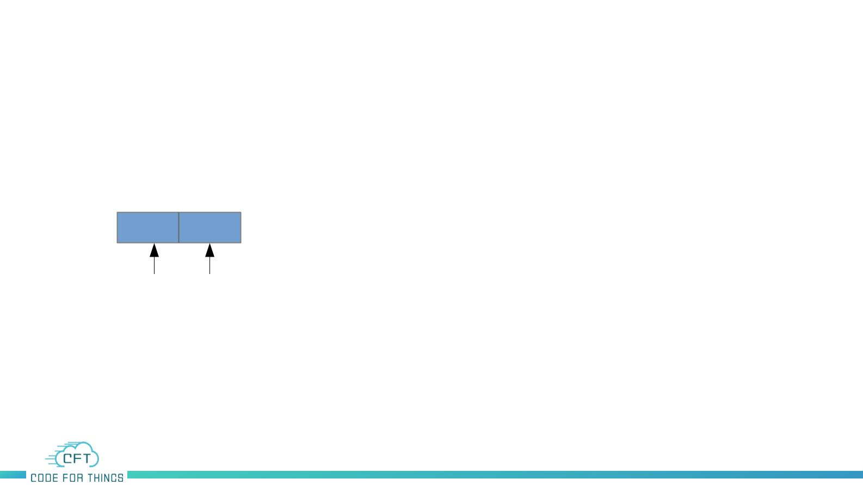
Data Structure –Stack Linked list
Operations
●
Linked list is a linear data structure that consists of sequence of nodes
which are connected to each other.
Data Link
●
Using a Linked List we can create a stack of variable size

Slide 5
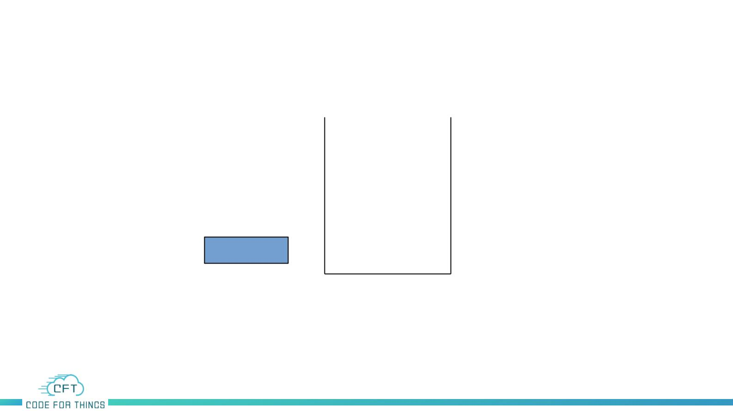
Data Structure –Stack Linked list
Operations
top
NULL
Stack

Slide 6
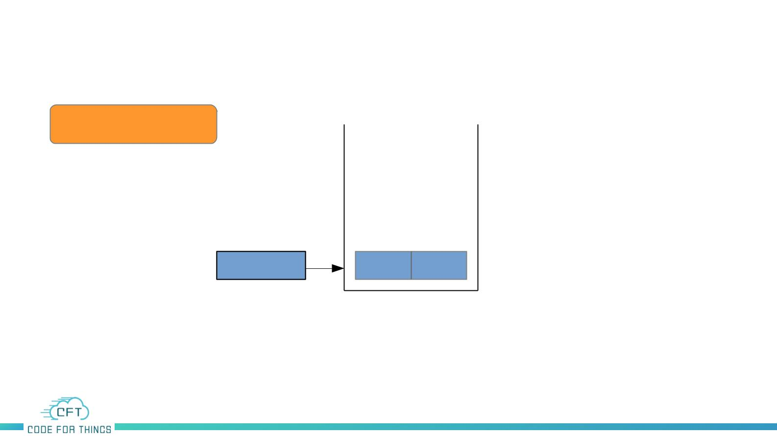
Data Structure –Stack Linked list
Operations
Push(10)
Push Operation
top
NULL
10
NULL
Stack

Slide 7
Data Structure –Stack Linked list
Operations
Push(10)
Push Operation
top
10
NULL
Stack

Slide 8
Data Structure –Stack Linked list
Operations
Push(20)
Push Operation
20
NULL
top
10
NULL
Stack

Slide 9
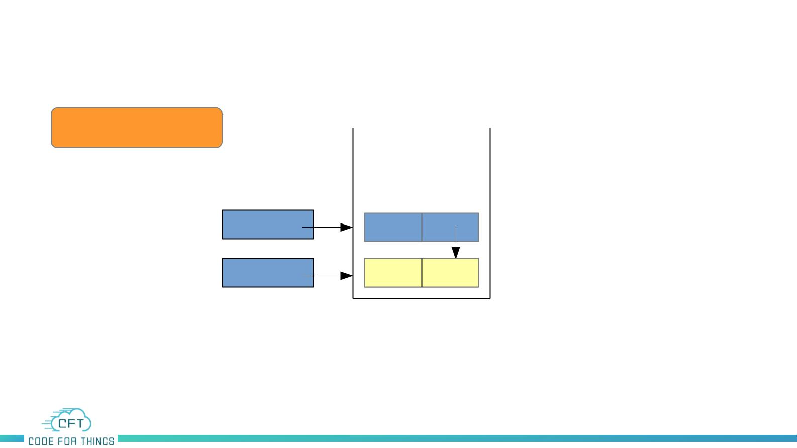
Data Structure –Stack Linked list
Operations
Push(20)
Push Operation
top
top
20
10
NULL
Stack

Slide 10
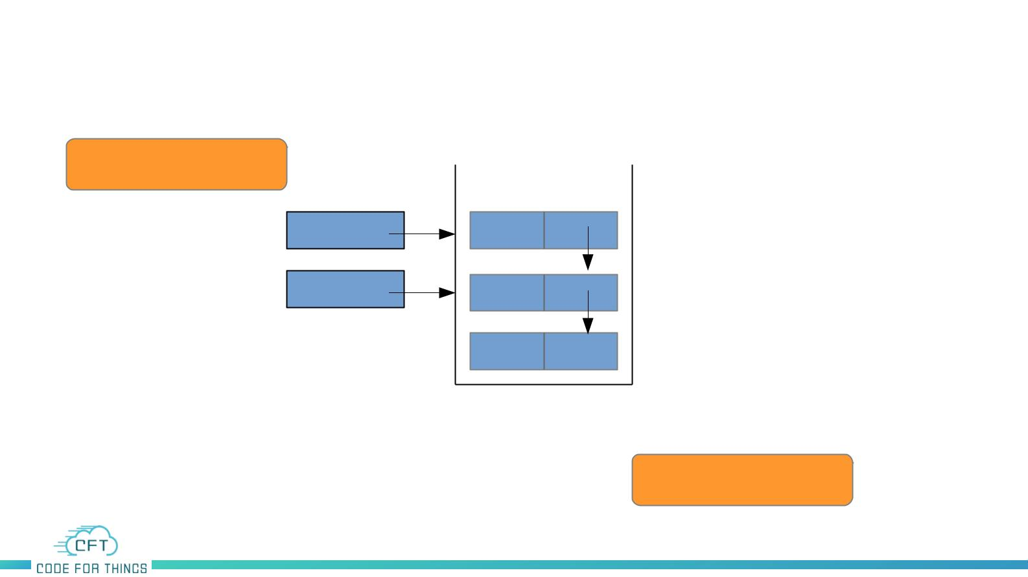
Data Structure –Stack Linked list
Operations
Push(30)
Push Operation
top
30
20
top
10
NULL
Stack

Slide 11
Data Structure –Stack Linked list
Operations
Push(30)
Push Operation
top
30
20
top
10
NULL
Stack
insert_at_first()

Slide 12
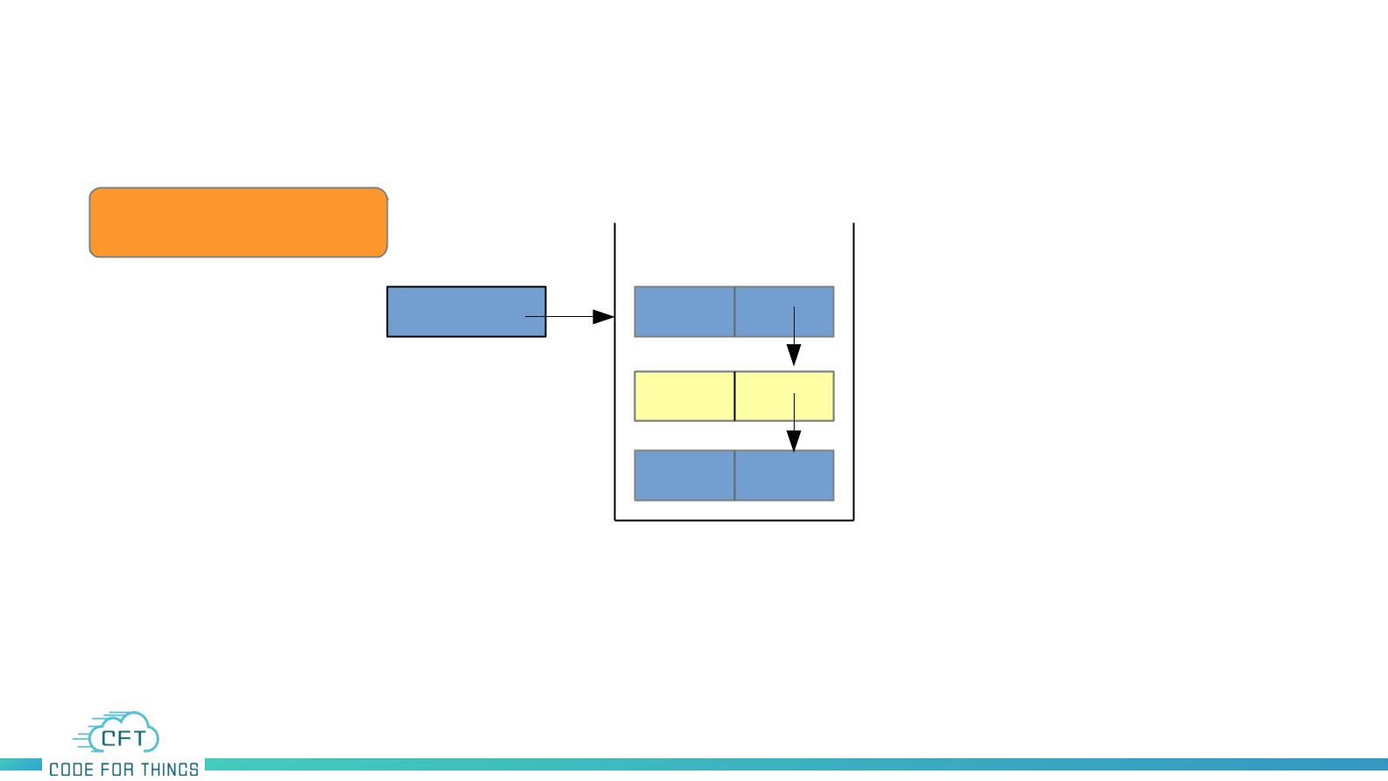
Data Structure –Stack Linked list
Operations
Pop()
Pop Operation
top
30
20
10
NULL
Stack

Slide 13
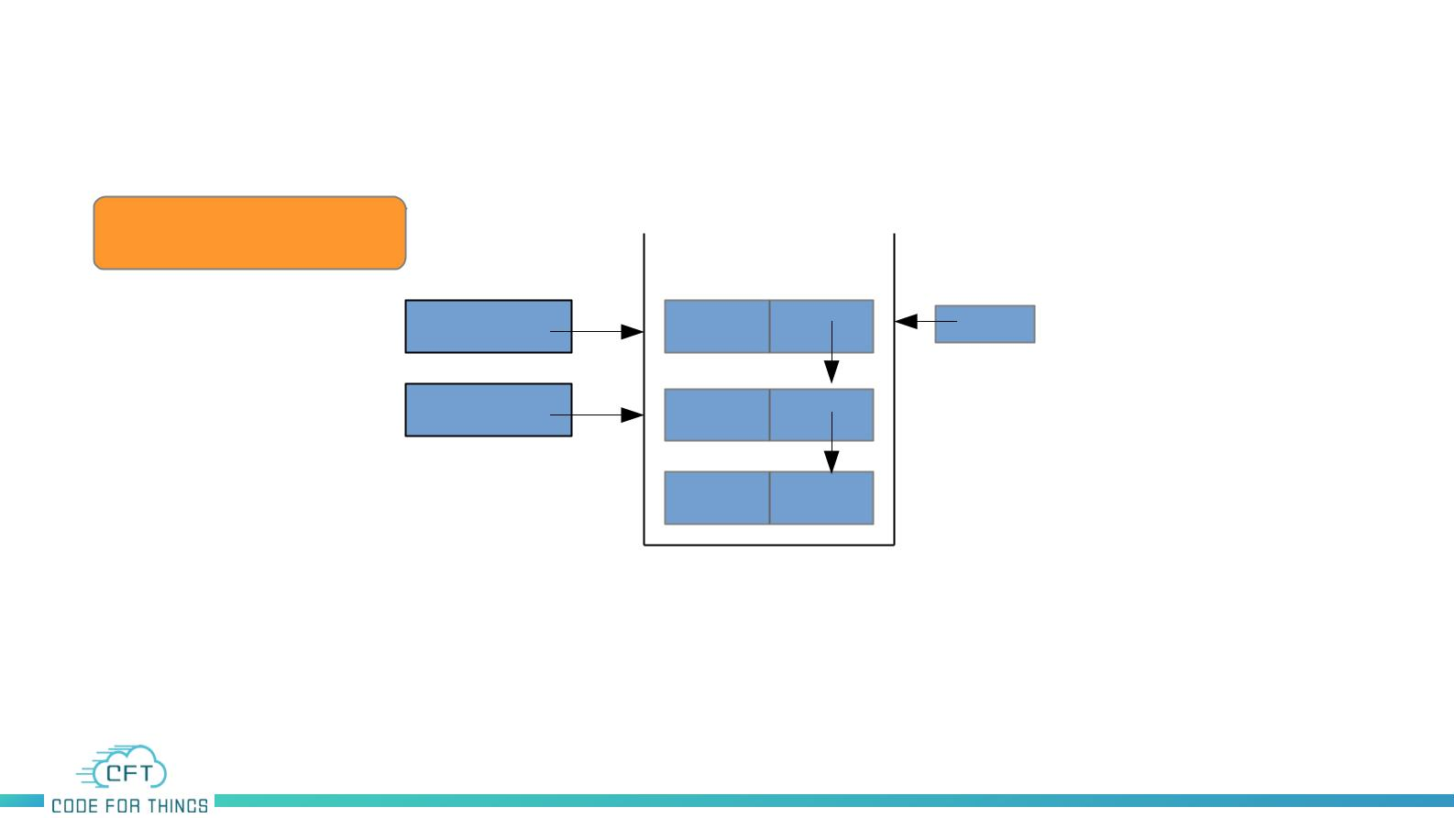
Data Structure –Stack Linked list
Operations
Pop()
Pop Operation
top
temp
NULL
30
top
20
10
NULL
Stack

Slide 14
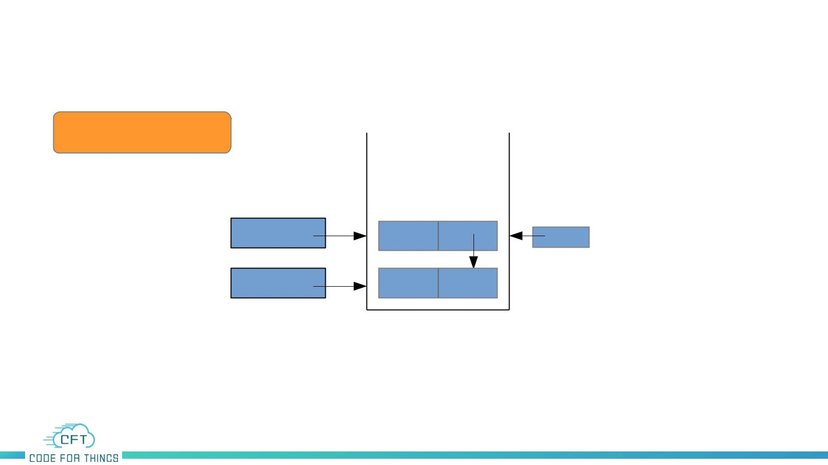
Data Structure –Stack Linked list
Operations
Pop()
Pop Operation
top
top
temp
NULL
20
10
NULL
Stack

Slide 15
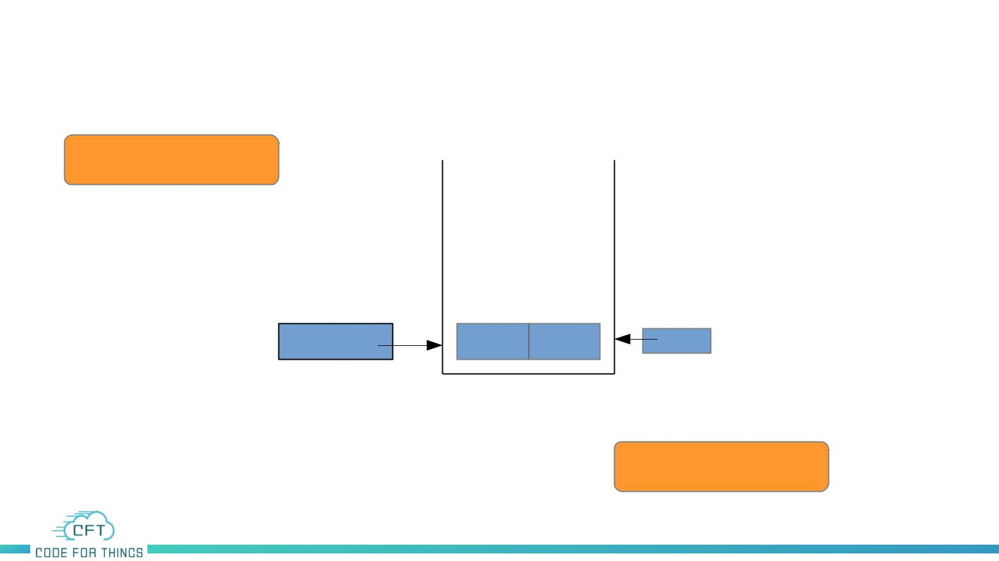
Data Structure –Stack Linked list
Operations
Pop()
Pop Operation
top
temp
NULL
NULL
10
NULL
Stack
delete_at_first()

Slide 16
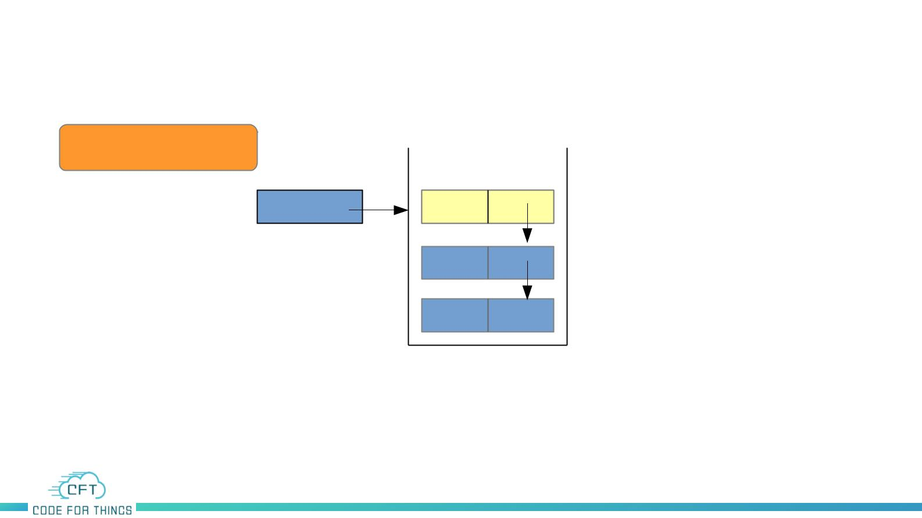
Data Structure –Stack Linked list
Operations
Peek()
Peek Operation
top
30
20
10
NULL
Stack

Slide 17

Data Structure –Stack
Summary
●
Stack is Linear Data Structure
●
Last in First out (LIFO)
●
Insertion or Deletion happens at one end called top.
●
Time complexity is O(1)
●
Implementation
●
Array
●
Linked List
●
Applications
●
Conversion of Expressions

Slide 18
Code – Stack Linked list

